Slide 1

Automating accessibility within the learning management system
Accessing Higher Ground, November 2017

Slide 2
Today’s Speakers
David J. Rowe
Director, Distributed Learning Technologies
Chico State University
djrowe@csuchico.edu
Jeremy Olguin
Manager, Office of Accessible Technology and Services
Chico State University
jdolguin@csuchico.edu
Nicolaas Matthijs
Product Manager, Blackboard Ally
Blackboard
nicolaas.matthijs@blackboard.com

Slide 3
Goals of this presentation
Introduce you to Chico State
Discuss some of our accessibility challenges
Share our approaches and technical solutions
Highlights our vendor partnerships
Share next steps
Q&A

Slide 4
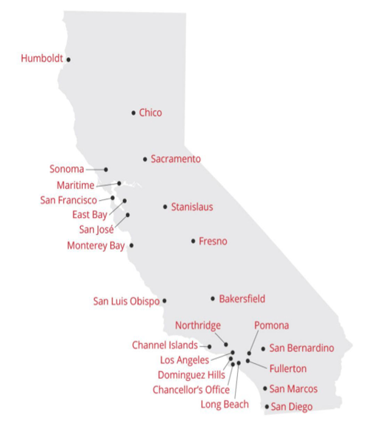
About Chico State
Chico State was founded in 1887, making it the second oldest CSU campus in the state.
Our students come from 46 nations, 37 states and 2 US territories.
The University has been rated a top-10 regional public university in the West by US News and World Report since 1998, when the rankings began.
Total Number of Students 17,557
Freshmen: 3,973 (23%)
Sophomores: 2,581 (15%)
Juniors: 4,175 (24%)
Seniors: 5,719 (33%)
Postbaccalaureate: 1,109 (6%)

Slide 5
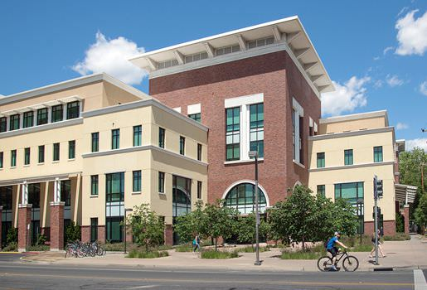
Accessibility at Chico State
California State University ATI Policy
Executive Order 926
13 member ATI team
Student Affairs, Information Resources, Library, Human Resources, Business & Finance, Associated Students
15 member remediation team
2 Staff, 13 student assistants
Executive level support
Bi-Monthly meetings with Provost, VP for Student Affairs, Chair of Academic Senate

Slide 6
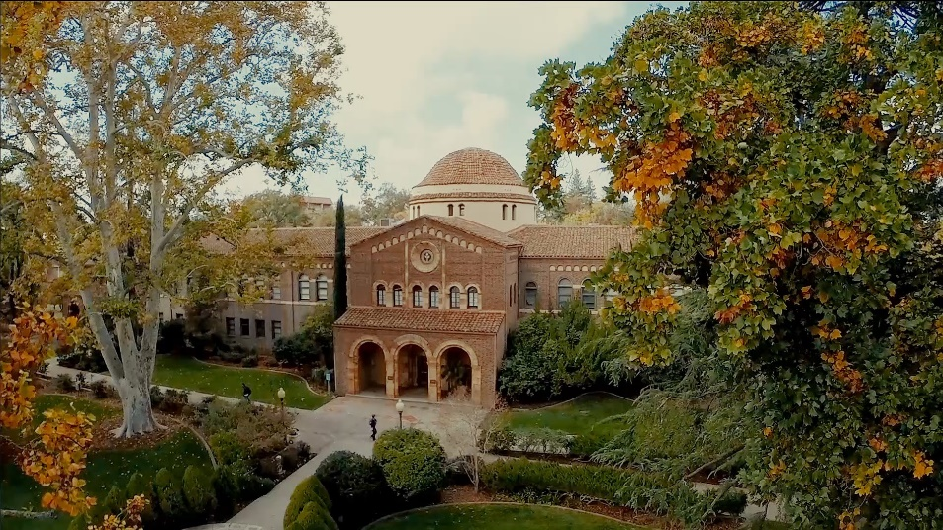
Functional Considerations
ADA Section 508 (Refresh)
Lawsuits inside and outside our university system.
No ability to inventory all content items.
LMS often termed “The Wild West.”
Tool availability
At times tools only partially helped (Band-Aid)
Campus Resources
Working in an environment with funding constraints

Slide 7

Technical Considerations
Content management and remediation
Video - inventory, assessment, business needs and vendor partnership. (Kaltura)
Content – lather, rinse, repeat (Blackboard Ally)
System complexity and mitigation
Scope, approach and adjustments

Slide 8
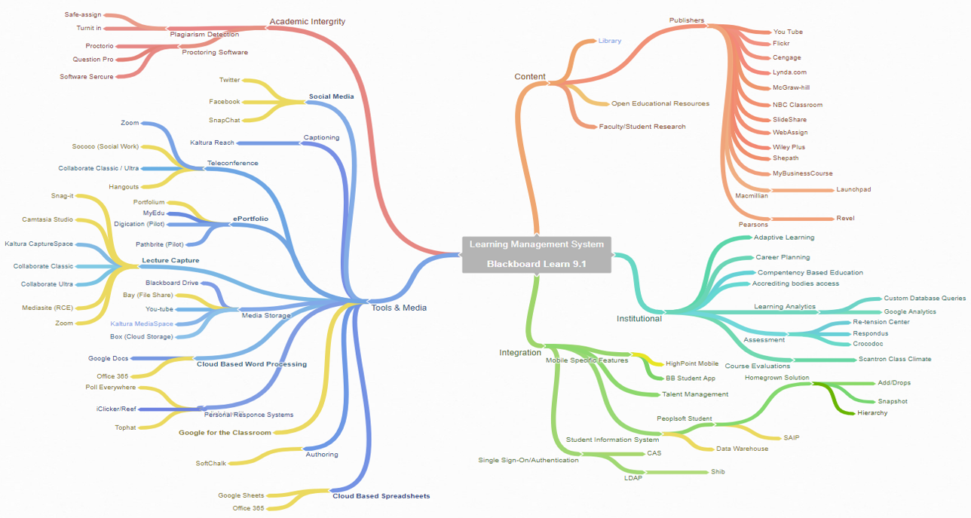
Learning Management System

Slide 9
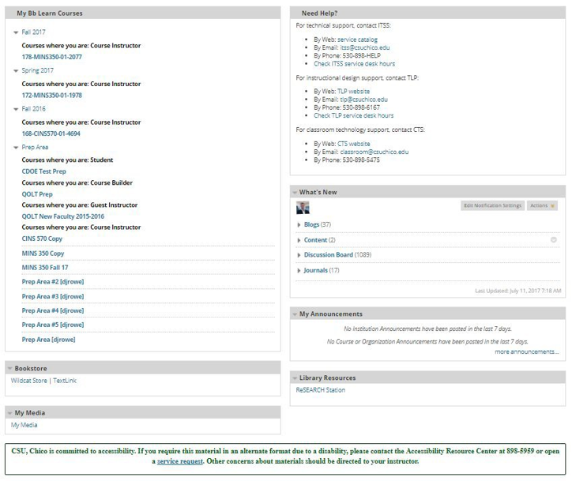
Step 1: System Mitigation
ATI Footer - Pre course login, add a disclaimer and a link to OATS help desk/service request
Incorporate Browser Compliance Testing: Chrome, Firefox, and Edge were incorporated into our change management testing process
Inventory scan the system with Compliance Sheriff/Site Improve - Complete Fail!
a. Enter Plan B

Slide 10
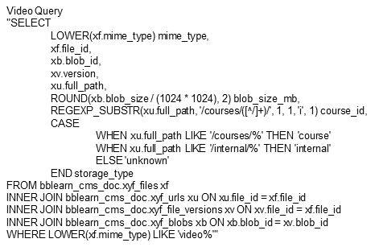
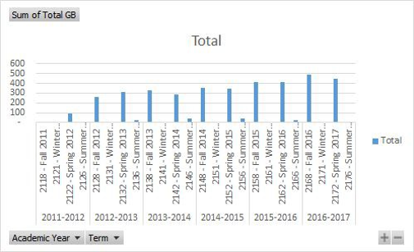
Plan B - Step 1: Video Management
Video assessment within Blackboard Learn (1.3T).
Student uploaded video = 832 GB
Registrar data retention policy (5 years)
BBLearn enhancement request redirecting future video
Faculty service request to bulk delete student video submissions from a completed course.
Faculty/Course owned video = 498 Gb
30 of 1007 Faculty manage 312G, or 62%
Identify a new Video Management Solution. Business needs included
Hosting with LMS Integration
Streaming
Web-Cam Recording
Auto-Captioning
Open Framework for API integration

Slide 11
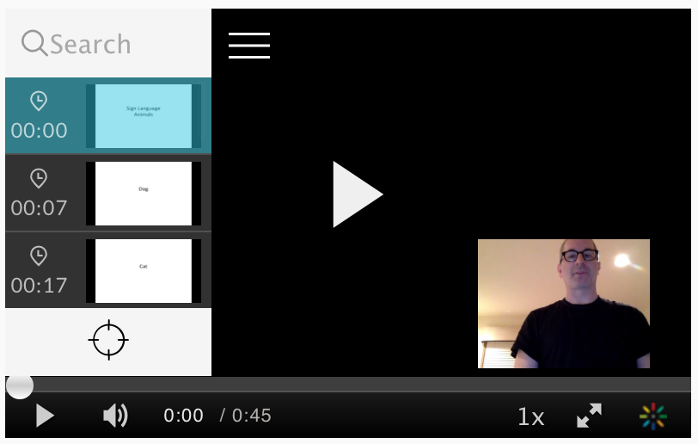
Kaltura Video
Chico State’s new contract includes:
KAF
MediaSpace
CaptureSpace
REACH
Youtube connector
Unlimited storage and bandwidth
Video Advantages over LMS Hosting:
Can be viewed and reviewed as often as desired
Reduces reliance on immediate attention/ note-taking
Can be viewed on a variety of devices
Advanced analytics
Translations - CCs can be provided in multiple languages
Speed Selector - Videos can be viewed at various speeds
Sign-Language or Descriptive Insets

Slide 12
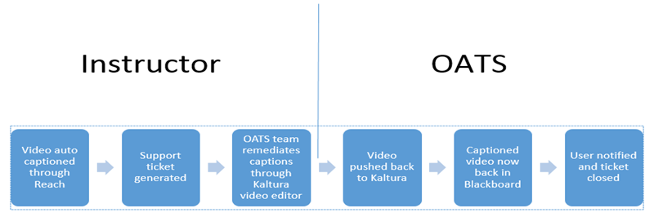
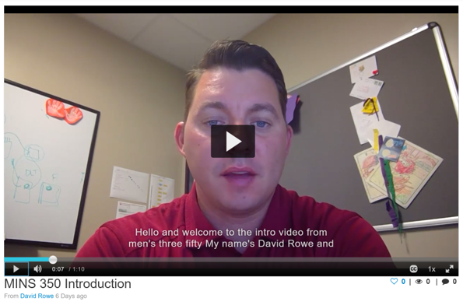
Workflow
Kaltura Reach
Team Dynamix (Support ticket integrated into LMS)
OATS

Slide 13
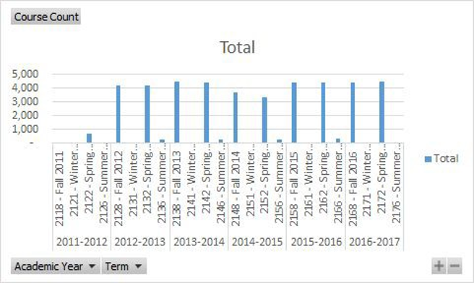
Plan B - Step 2: Content Management
Content assessment within Blackboard Learn (2T)
6 years of data
44k courses
Average 4k per term
Too much content for manual interventions
Identify a new scanning solution. Business needs included:
Integration with BBLearn 9.1
Could produce a LMS system-wide inventory
Offered a customer service based solution
Scanned everything other than video
Enter BB Ally

Slide 14
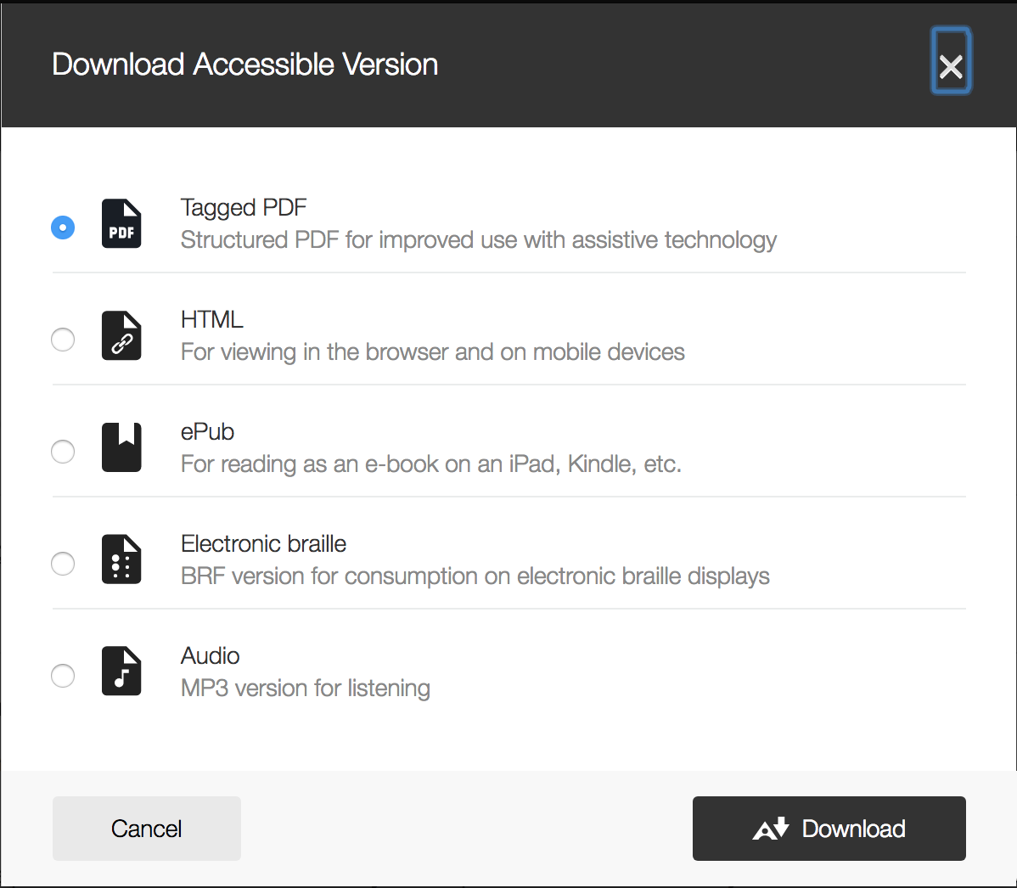
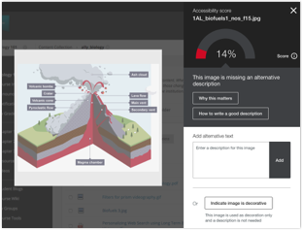
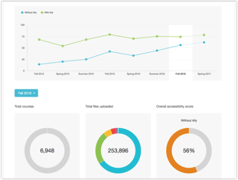
Alternative Accessible Versions
Automatically checks for accessibility issues and generates alternative accessible formats
Instructor Feedback
Guides instructors on how to improve the accessibility of their course content and alters future behavior
Institutional Report
Provides detailed data and insights to help further improve course content accessibility at the institution

Slide 15
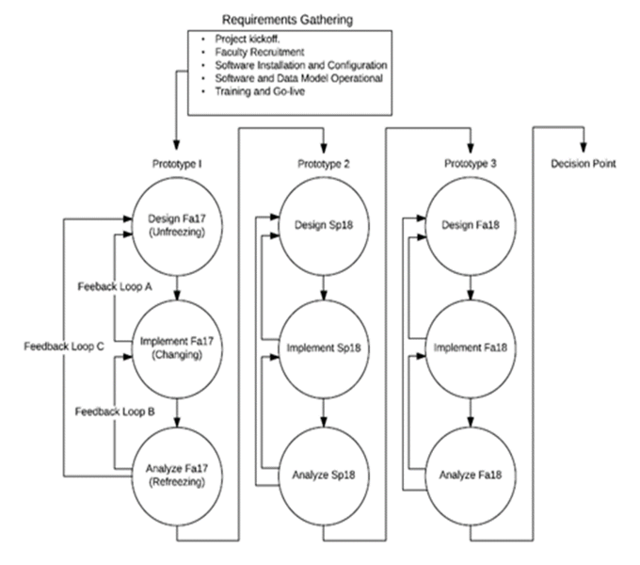
Scope and Approach
Scope:
Iterative and incremental campus wide implementation over an 18 month period. This will include configuration and communication plans, as well as how the tool will inventory learning management system content for accessibility and compliance. The Iterative Roll-out Approach will include four phases:

Slide 16
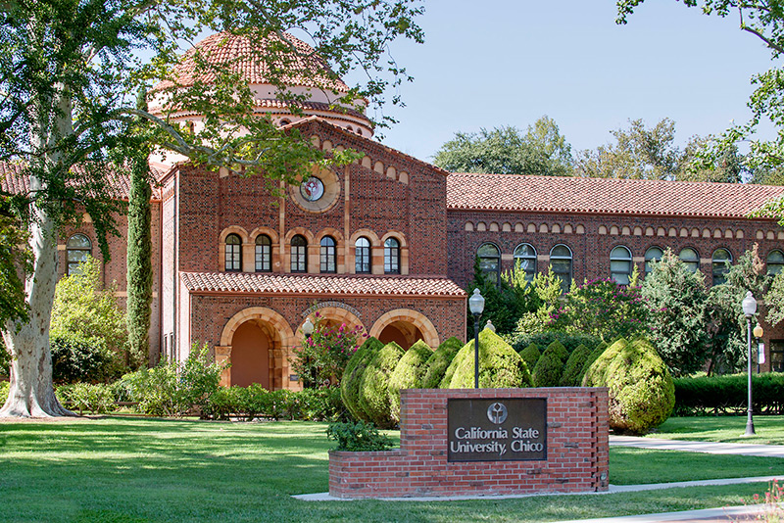
Organizational Considerations
Project Ownership and Governance
Continue collaborative efforts
(OATS-Remediation/Communication, IRES-Functional testing/support/installation)
Expectations of Faculty
Faculty will be expected to evaluate their own materials and use Ally self-remediation capabilities

Slide 17
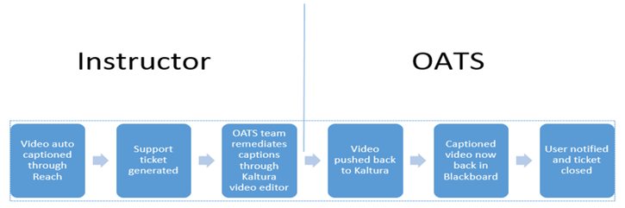
Ally Pilot
11 Faculty
200 pieces of material
Using Ally as a secondary scanner
University response
What about outside the LMS?
Remediation “high touch”

Slide 18
Ally Pilot Continued
Remediation “high touch”
Left faculty on their own for 5 weeks.
Scores did not change
Broke content into faculty work and OATS remediation tasks and emailed.
Zoom sessions
We have seen a 30% increase in score from pilot group.

Slide 19
Ally Pilot Communication Example
Hi (instructor),
First off, thank you for participating in this pilot. We are very excited about what we are doing on this campus. Attached is your (Course Info) dashboard with your up to date accessibility score.
OATS would love to help you in improving that score. We have looked at your 29 content items and have found that 21 of those items could use our assistance. The remaining 8 are attached in a screenshot. Those 8 need alternative text which should take you no more than 10 minutes. If you look for this icon (insert icon) next to the content item it will walk you through how to add the alternative text. Should you need our help with that please contact us.
We want to make sure you get taken care of and for that reason we are assigning you a specific person from our office so you aren’t working with multiple people. For your course I am assigning myself and Student Assistant (cc’d). With your permission we would like to begin work on the 21 content items listed above.
Jeremy Olguin
Accessible Technology Manager
Office of Accessible Technology and Services
California State University, Chico
530-898-4863

Slide 20
What’s Next?
Enhance support model
Ally through web accessibility software?
Make it easier for students and instructors to reach out for help
Self-audit remediation team to continue improving the process

Slide 21
Questions?

